Slide 1


Blinkit Sales Data Analysis
BY:- Akash Panwar

Slide 2

IntroductionAbout Blinkit: Blinkit is an Indian quick-delivery app that serves many outlets with various product items.
Purpose of Analysis: To look at key data points from item sales and outlet details, and find simple insights that can guide future decisions.
Data Source:The analysis is based on a sample table that includes product items, Rating, outlet details, and sales numbers.

Slide 3
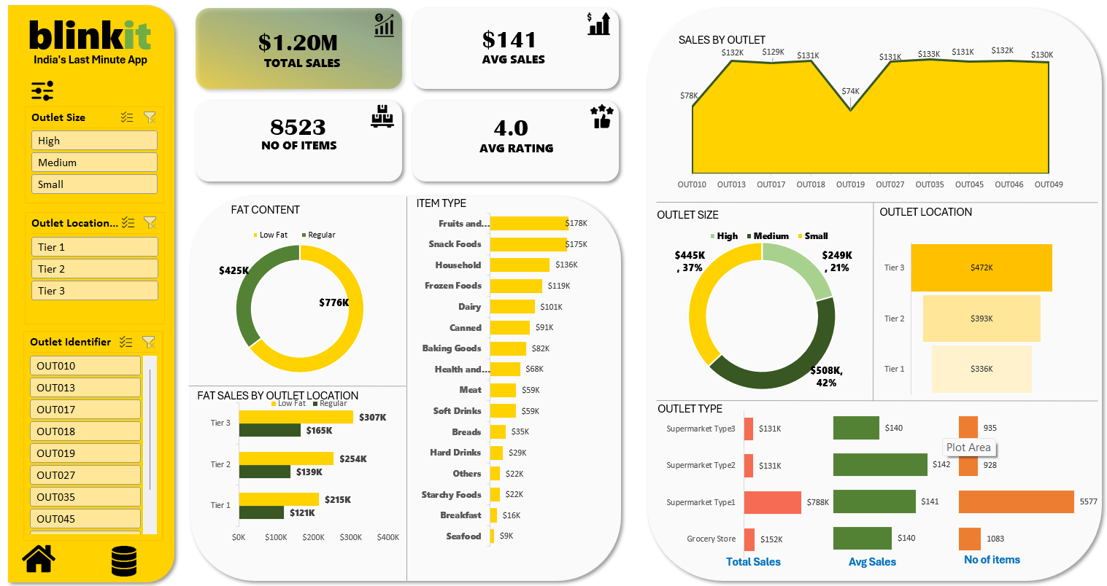

Slide 4
Key Figures
$1.20M
$141
8523
4.0
Total Sales
Average Sales per order
Number of Items
Average Rating

Slide 5
Fat Content Breakdown & Sales by Item Type
Key Insight:
Focus on promotions or inventory adjustments based on which fat content drives more sales.
Key Insight:
Categories like Fruits & Vegetables, Snack Foods, and Household items are top sellers. Consider strategic focus on these groups.

Slide 6
Sales By Outlet & Outlet Size and Their Contribution
Key Insight:
Investigate why OUT019 & OUT010 is lagging and consider targeted initiatives there.
Key Insight:
Tailor marketing strategies based on outlet size. Ensure small and high outlets both receive adequate attention.

Slide 7
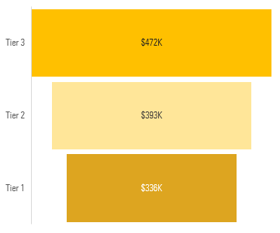
Sales by Outlet Location & Fat Sales by Outlet Location
Key Insight:
Tier 3 has the highest sales; strategies may be needed to uplift performance in Tier 1 locations.
Key Insight:
Regular Fat consistently outperform low fat in all tiers, indicating consumer preferences across regions.

Slide 8

Sales by Outlet Type
Key Insight:
Outlet type impacts overall revenue. It may be worthwhile to analyze customer behavior in each outlet type
Supermarket Type 1 leads in total sales due to a larger number of items, even though average sales are similar across types..
Total Sales
No of items
Avg Sales

Slide 9





Recommendations
Focus Promotions
Invest more in categories that are performing well.
Review Underperformers
Investigate lower sales at outlets like OUT019 & OUT019.
Location Strategies
Develop targeted campaigns for Tier 1 and Tier 2 locations.
Improve Inventory Management
Optimize stock levels based on top-performing product categories.
Expand Product Visibility
Highlight low-selling items in app banners or special sections to increase their visibility and potential sales.

Slide 10

Summary of Insights
The dashboard provides a clear view of Blinkit's sales performance.
Insights about product sales, outlet differences, and regional performance offer pathways for strategic improvements.
This analysis forms a basis for focused marketing, better resource allocation, and overall enhanced operational strategies.
Final Note
Thank you for your time!
Feel free to share any questions or feedback.

